Slide 1

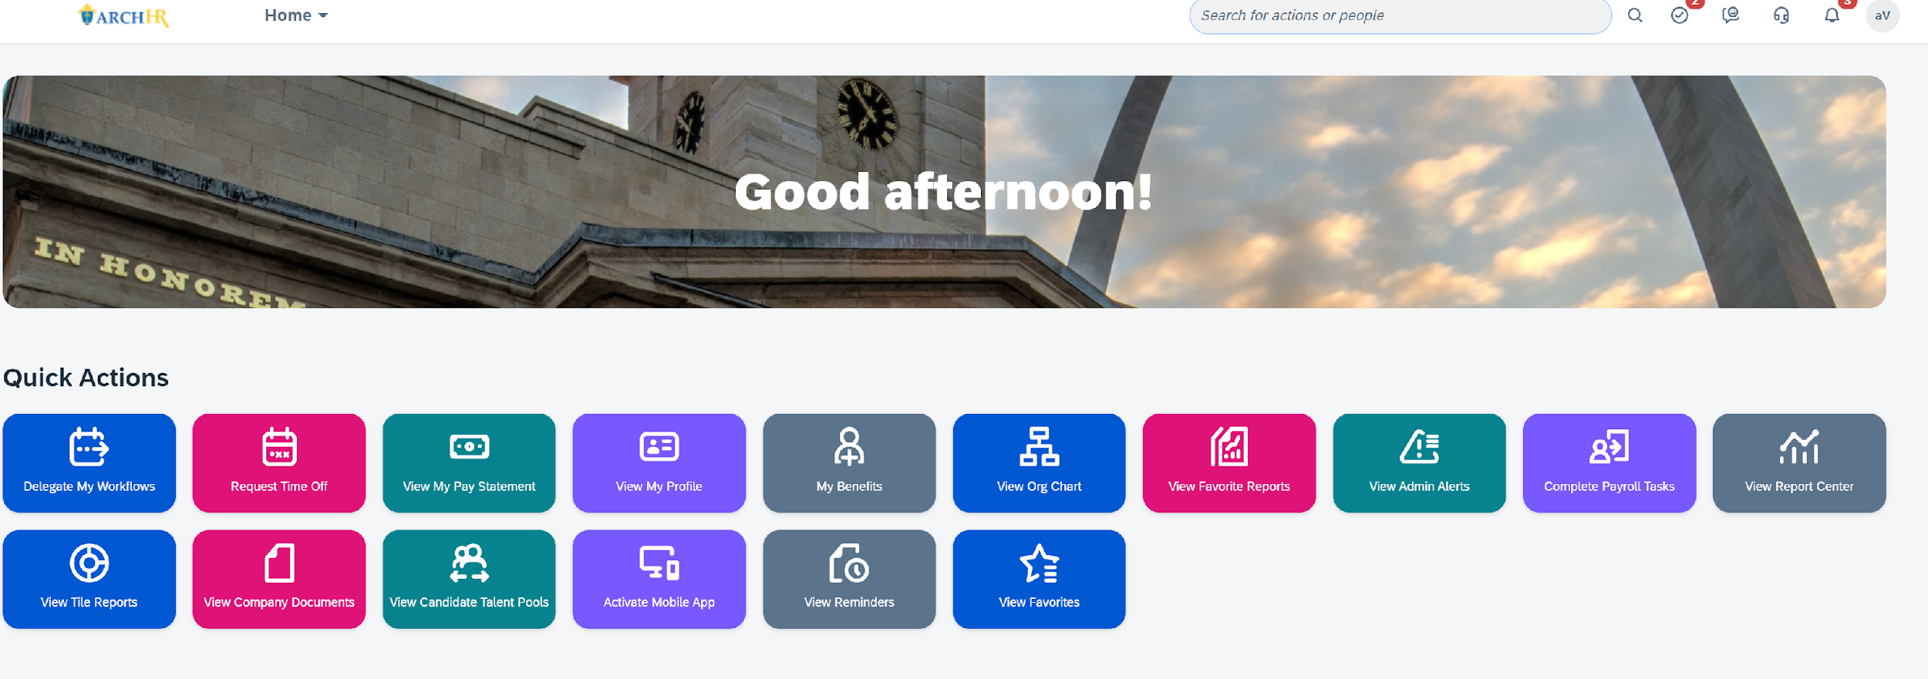
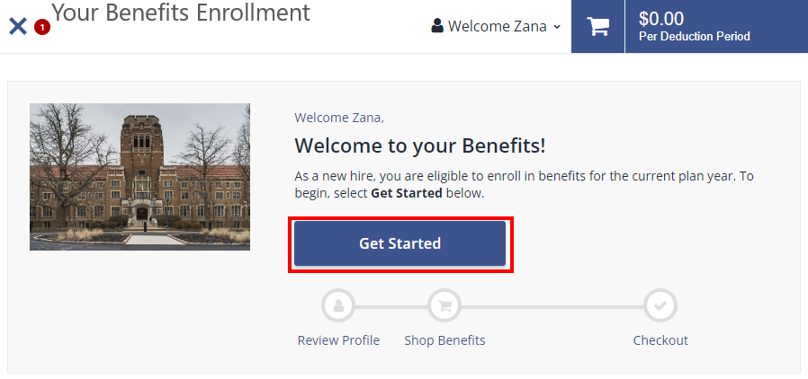
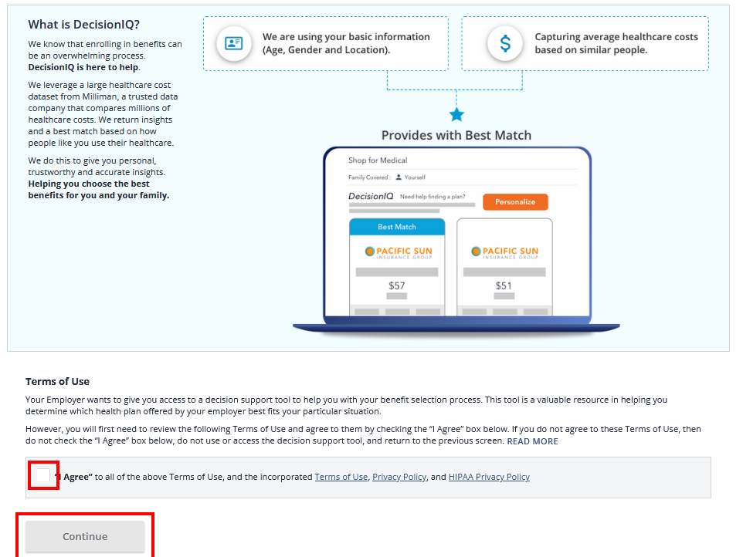
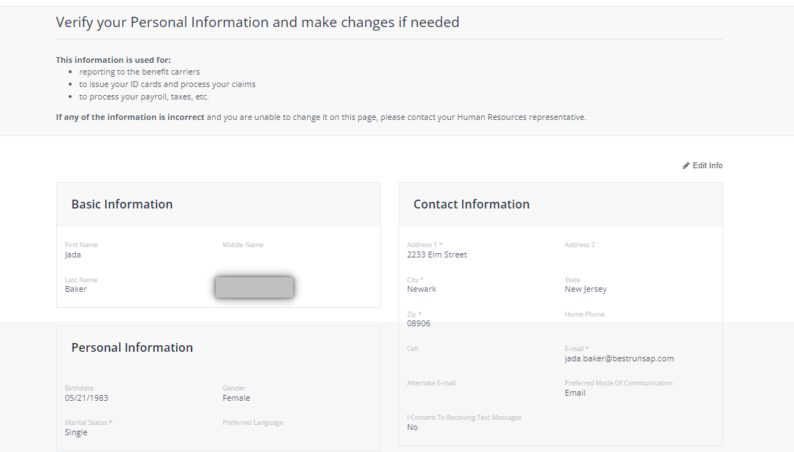

Quick Reference Guide: Employee New Hire Enrollment
1. From your Home Page, click on the “My Benefits” tile.
2. You will now see your Benefits Portal. Please read the Open Enrollment information and click on Get Started.
3. Review DecisionIQ decision support information, click I Agree and then Continue.
4. Verify your personal information. Please note that any changes to your personal information must be completed in your ArchHR Core Profile* Click on Next: Review My Family.
DecisionIQ is personalized and uses where you live, potential usage, age, and other data to recommend a plan. DecisionIQ is applicable to medical only since there are 3 plans to choose from.
*This is a separate step done outside of the ArchHR Benefits Open Enrollment process.
Last Modified Date: August 4, 2025

Slide 2
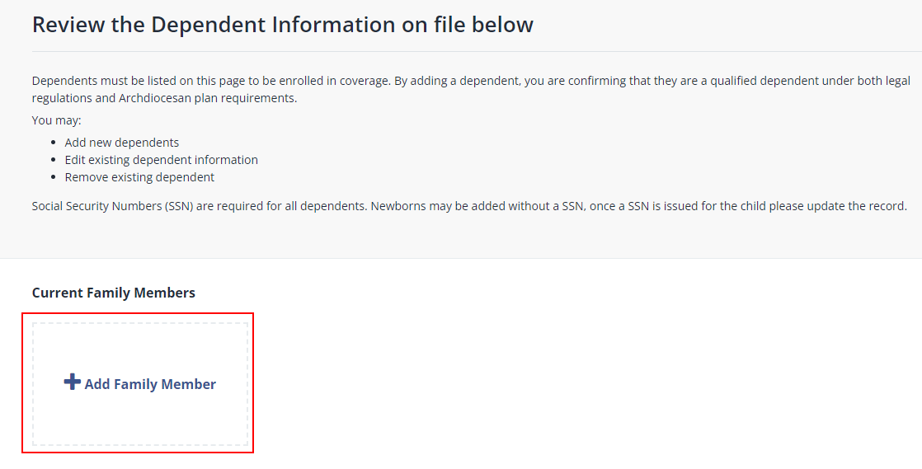
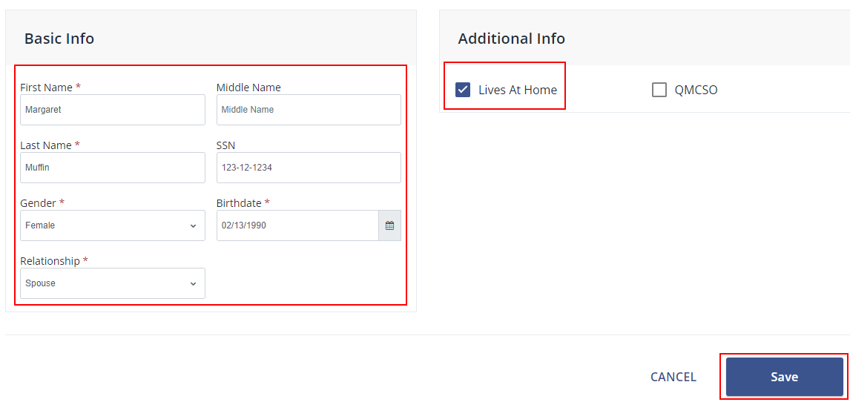
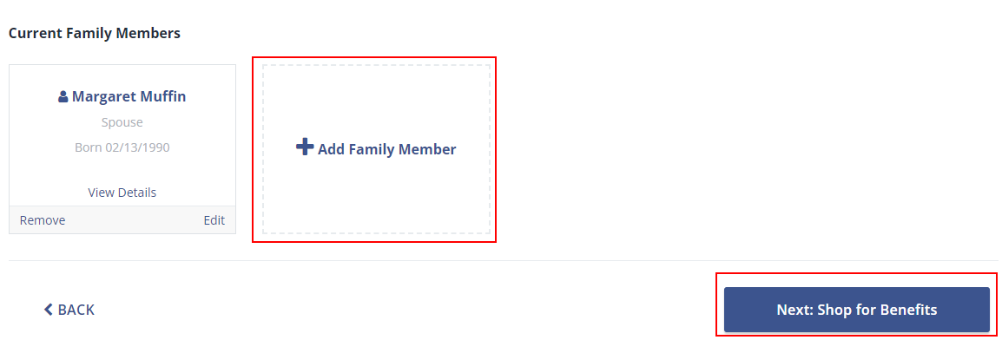
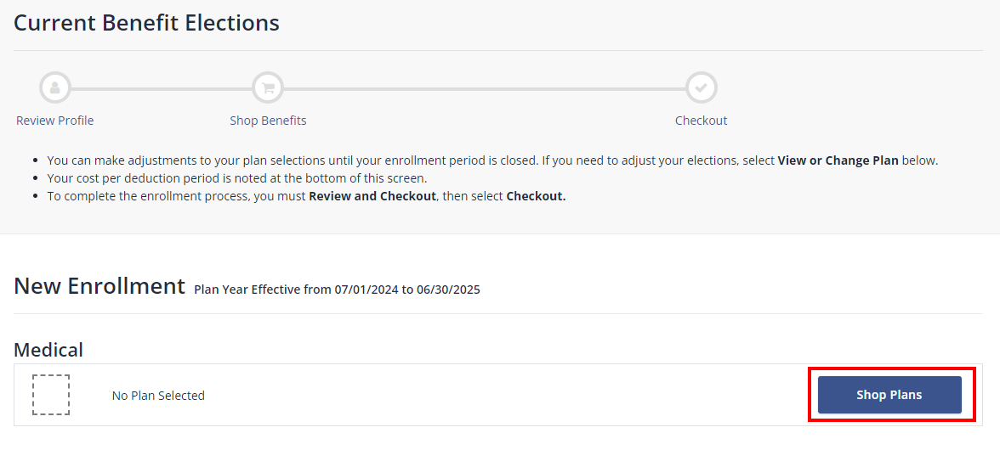
Quick Reference Guide: Employee New Hire Enrollment
5. Add or Edit your dependent information. To add a dependent click + Add Family Member.
6. Enter the specific information for each dependent to be covered. TIP: If the dependent does NOT live at home, uncheck the ‘Lives at Home’ box and enter their address. Click Save.
7. If you have existing dependents that need to be edited or removed, click on “Remove” or “Edit” within the dependent tile. When dependent adds, removals, and edits are complete, click on Next: Shop for Benefits.
8. Begin your enrollment by clicking Shop Plans for Medical.

Slide 3
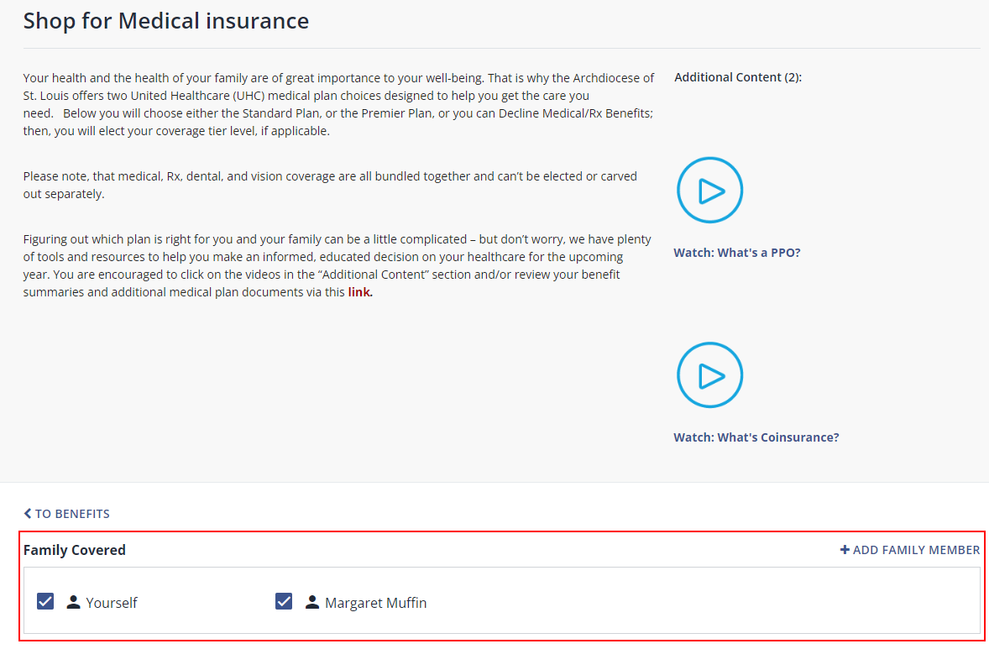
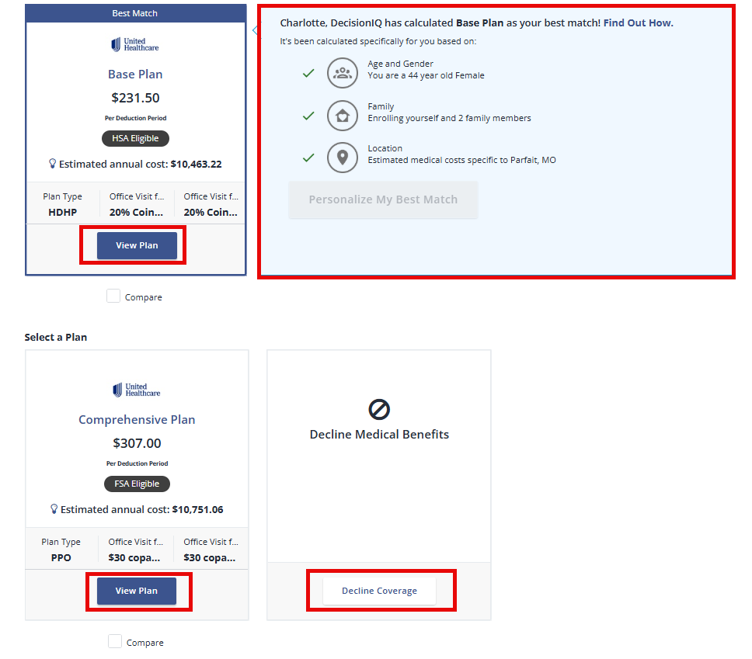
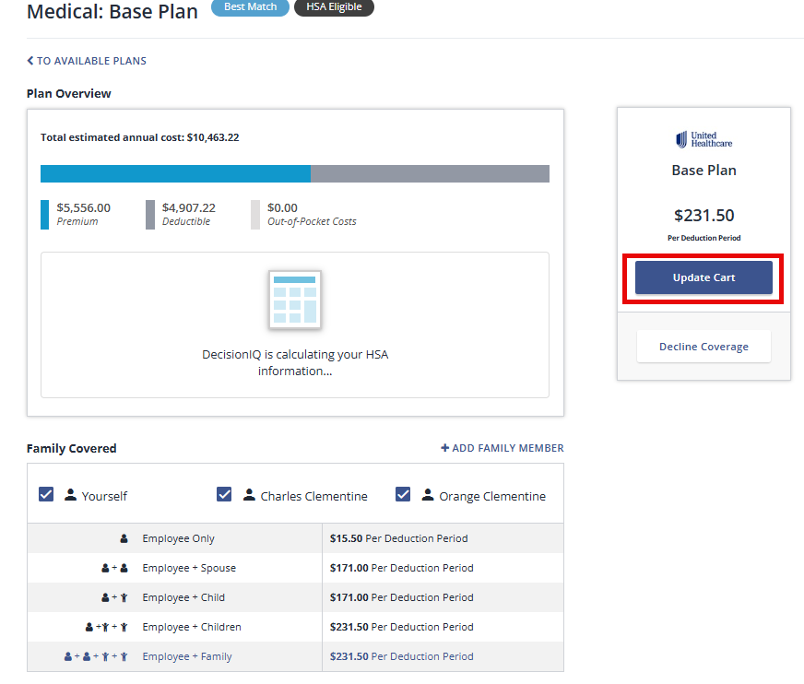
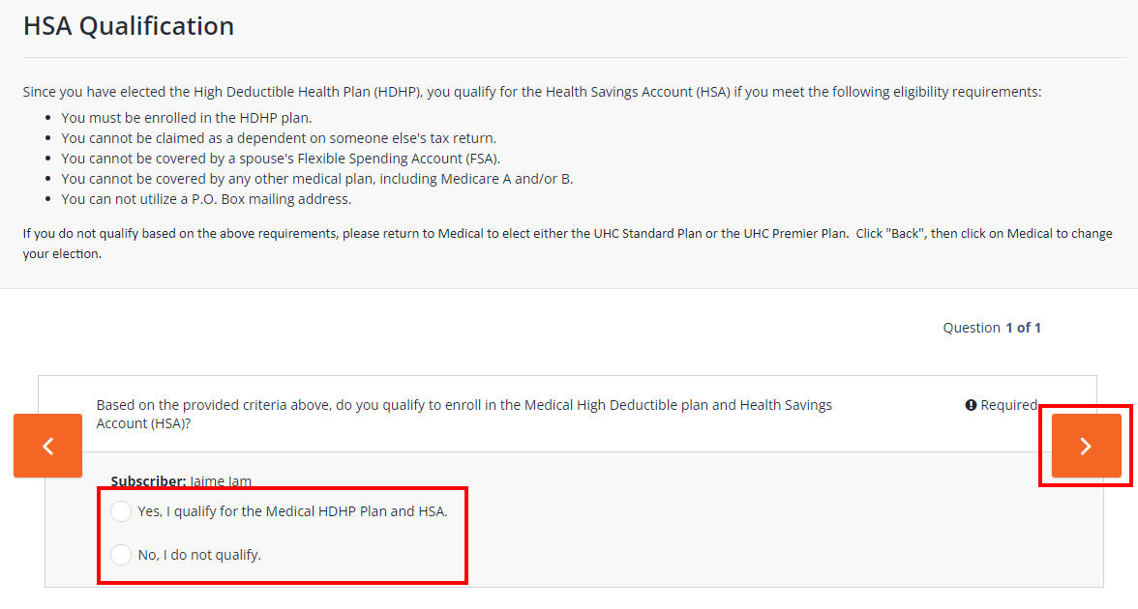
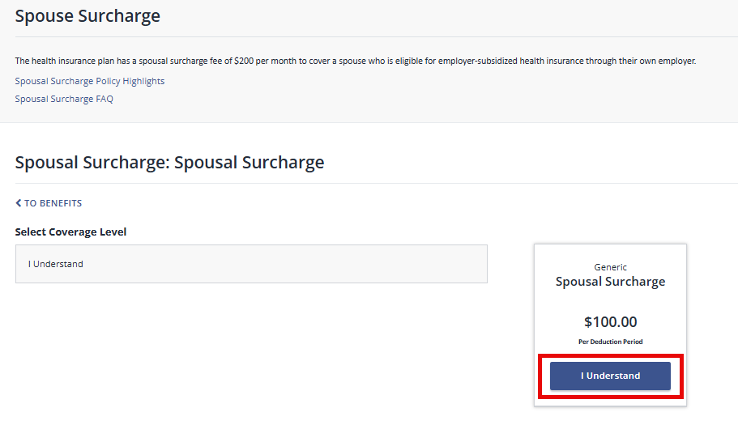
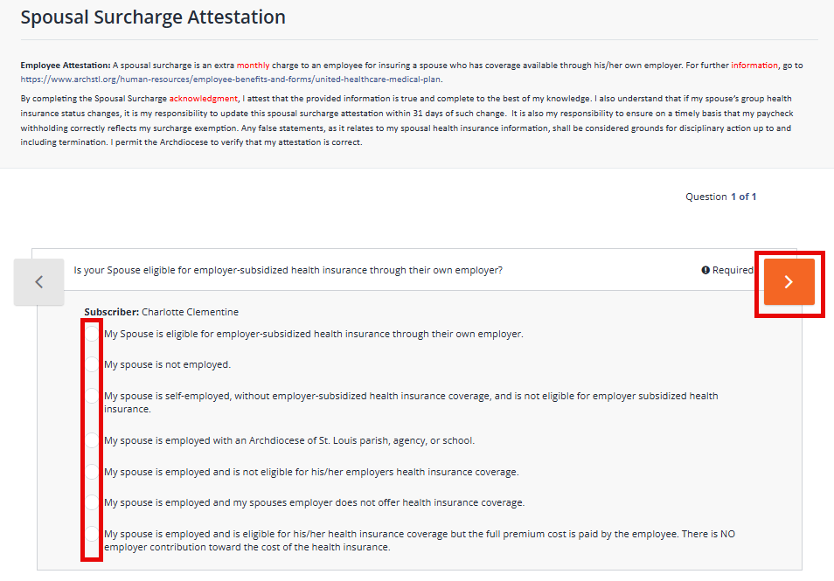
Quick Reference Guide: Employee New Hire Enrollment
9. Select or add any dependents you would like to cover based on the benefit type in the Family Covered Box.
10. DecisionIQ is available to assist you when making a choice for Medical/Rx benefits. Click on View Plan to see details and to “compare”.
11. Identify the Medical plan you would like to enroll in and click Update Cart.
DecisionIQ is personalized and uses where you live, potential usage, age, and other data to recommend a plan. DecisionIQ is applicable to medical only since there are 3 plans to choose from.
Eligible Dependents are auto-selected as a default
12. If enrolling in the Base Medical plan, review and answer the eligibility question for HSA plan enrollment. Click the right Arrow, then Save.
13. If you are choosing to cover a Spouse, you must complete the Spousal Surcharge Attestation. Select the applicable survey response, click the right Arrow, and Save.
14. Depending on your answer, you may see the Spousal Surcharge page. Select I Understand.
If you are not eligible for an HSA account, please click “Back” and select the UHC Comprehensive Plan.

Slide 4
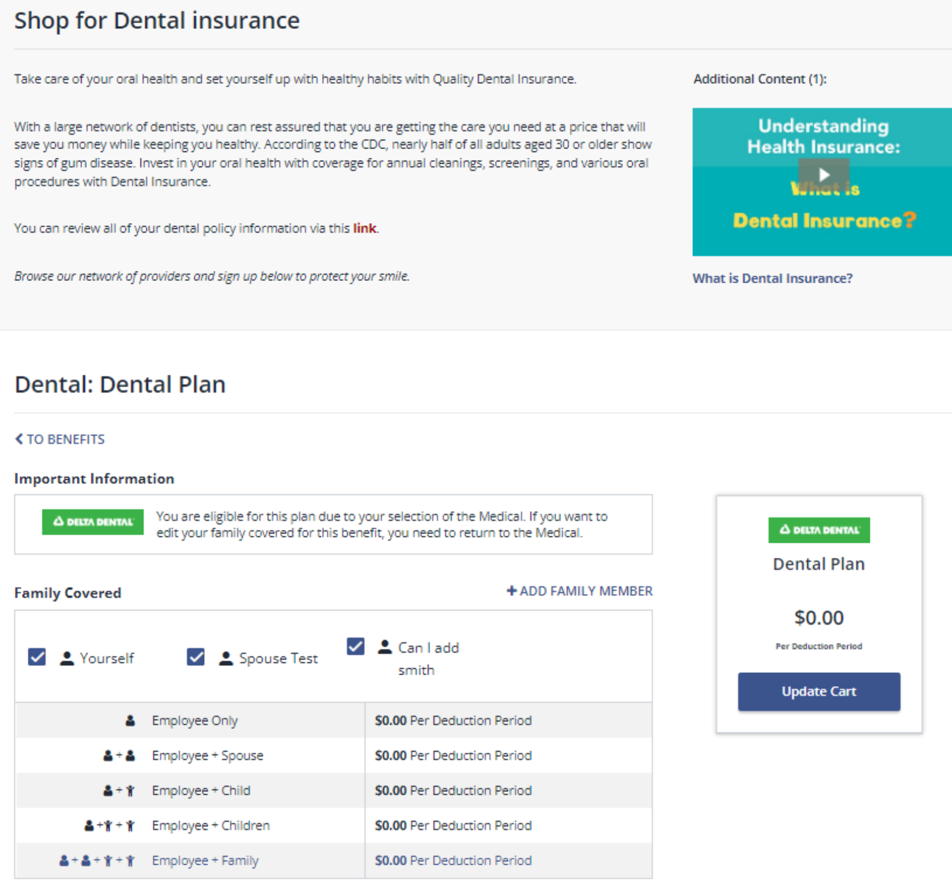
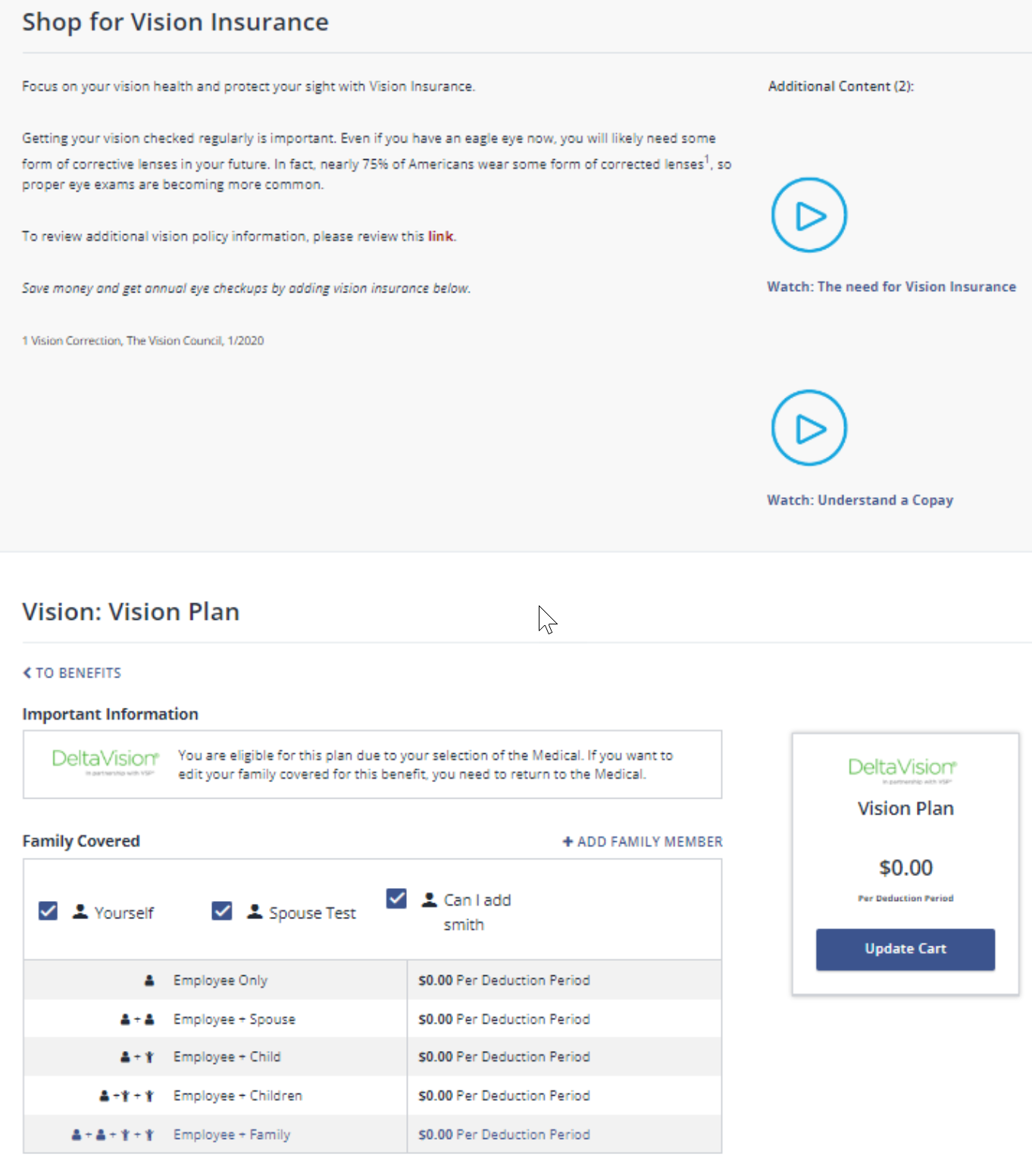
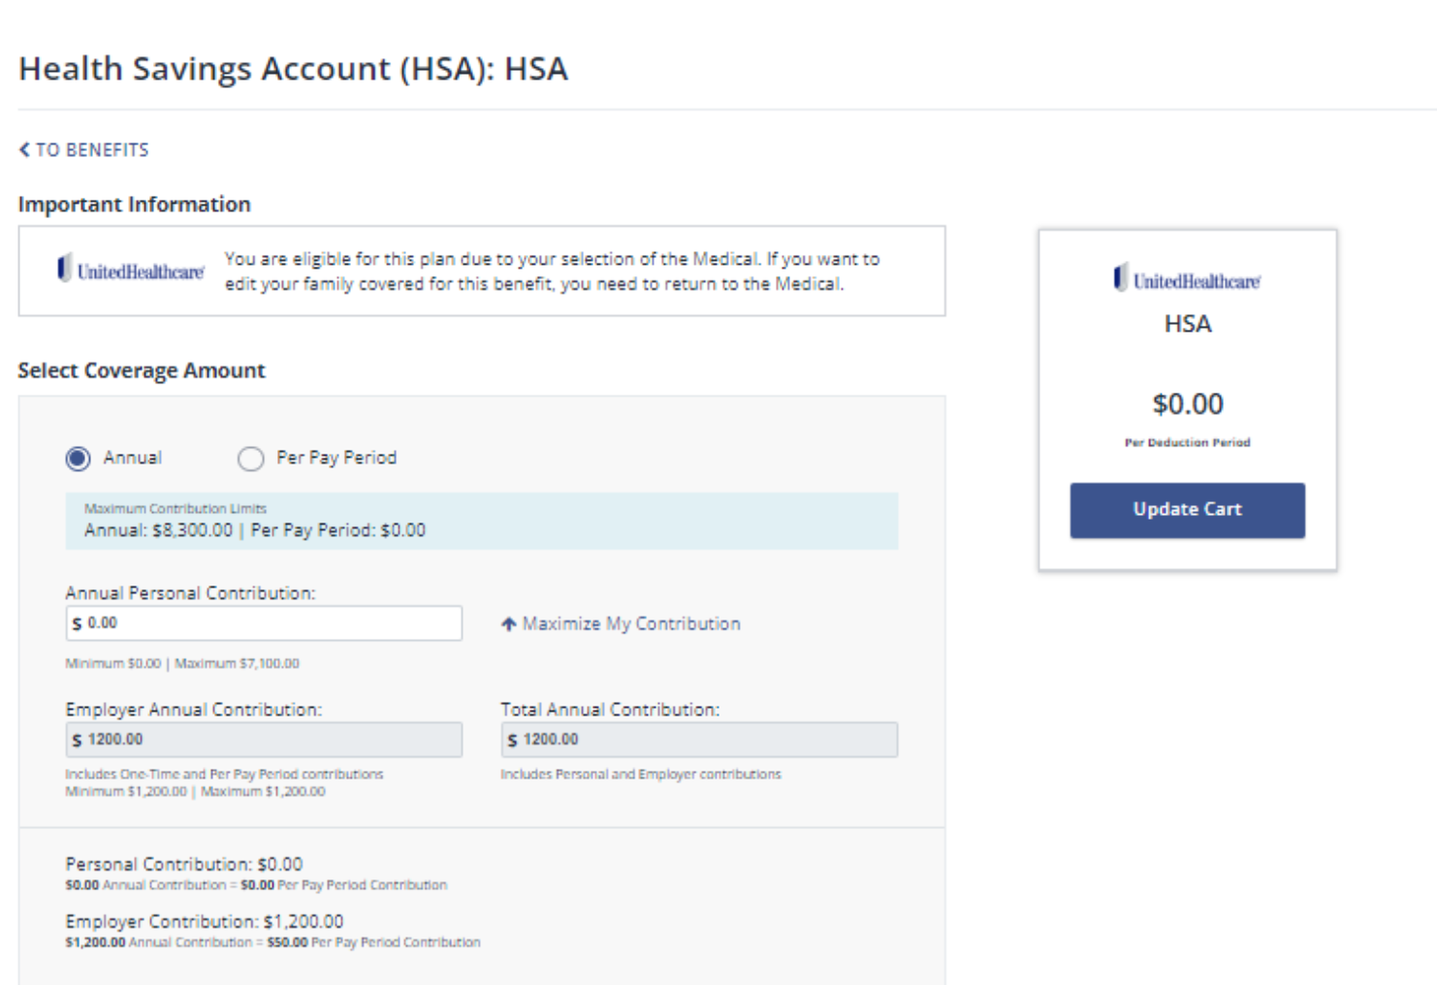
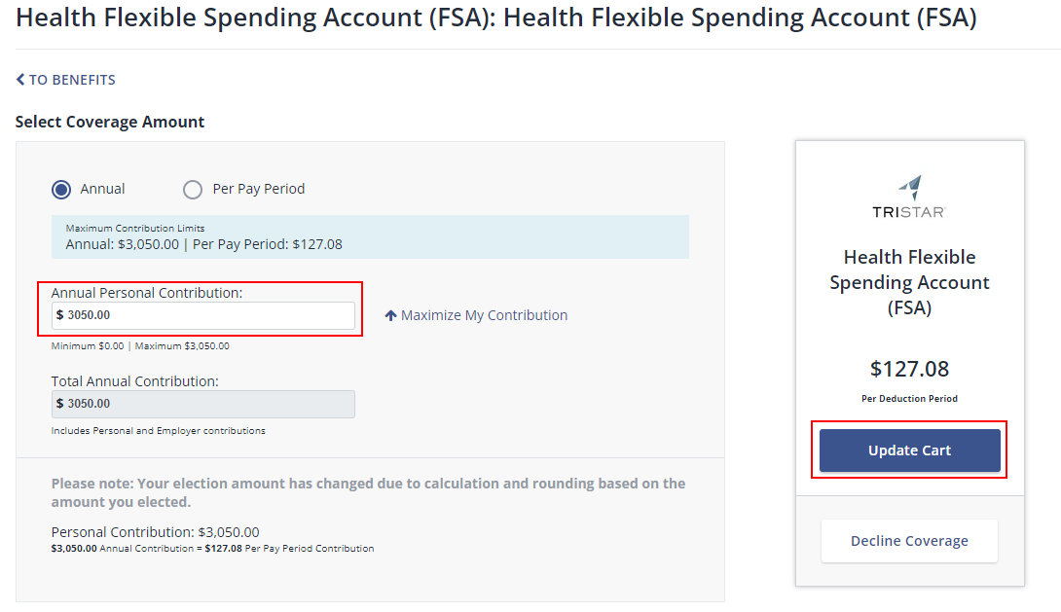
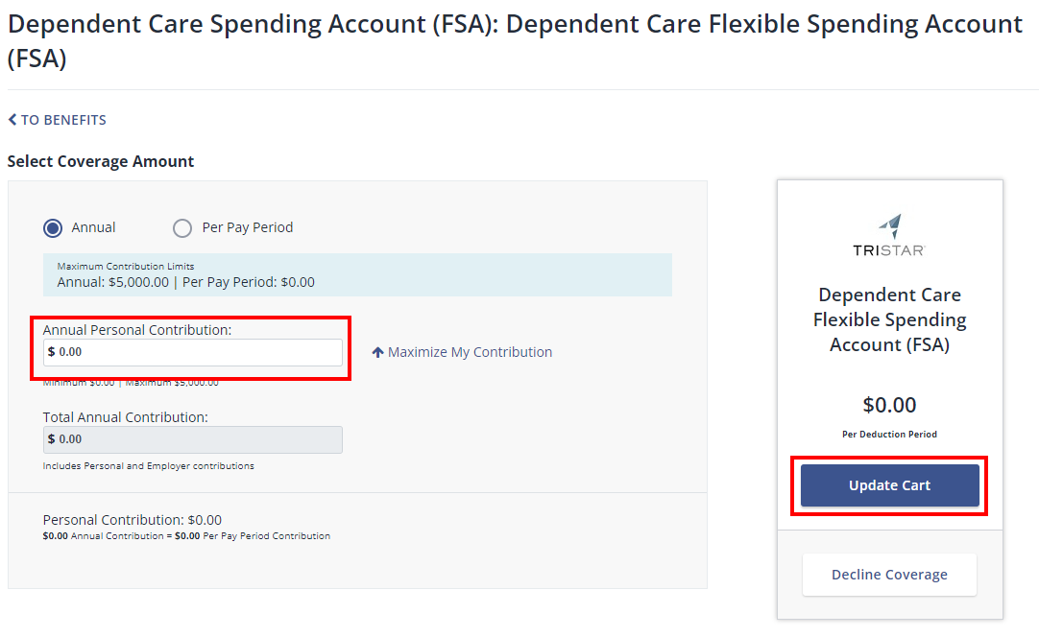
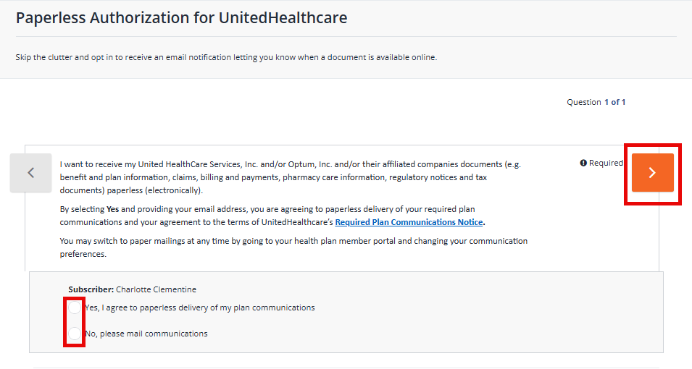
Quick Reference Guide: Employee New Hire Enrollment
15. Review the Dental plan you will be enrolled in and click Update Cart.
16. Review the Vision plan you will be enrolled in and click Update Cart.
17. If enrolling in the HSA plan, you can enter a personal contribution amount, if desired. Click Update Cart when done.
DecisionIQ is personalized and uses where you live, potential usage, age, and other data to recommend a plan. DecisionIQ is applicable to medical only since there are 3 plans to choose from.
Eligible Dependents are auto-selected as a default
You may choose not to add employee contributions to the HSA; you will still receive the Archdiocese’s contribution amount.
18. If you are eligible and choose to enroll in a Health Flexible Spending Account, enter your contribution amount and click Update Cart.
19. If you are eligible and choose to enroll in a Dependent Care Flexible Spending Account, enter your contribution amount and click Update Cart.
20. If you are enrolling in Medical, you will be required to complete the Paperless Authorization. Select your preference, the Arrow to the right, and Save.
If enrolled in the Base Medical Plan with HSA, you will not be eligible to enroll in FSA.

Slide 5
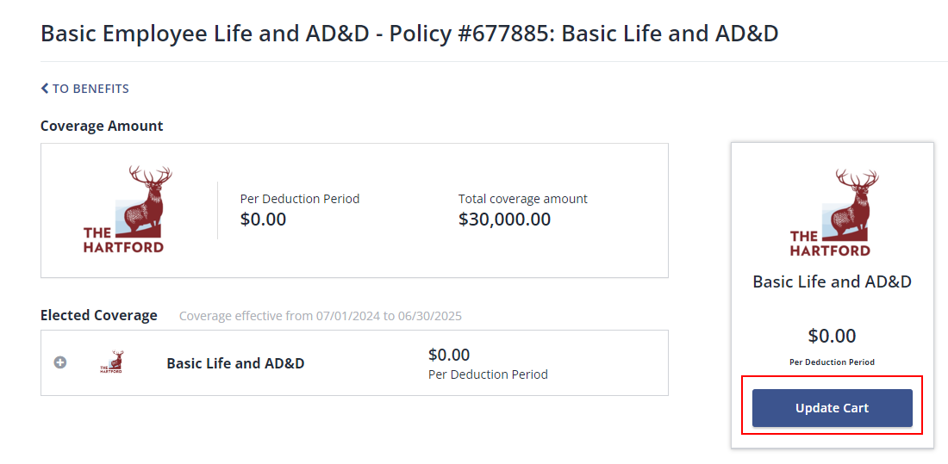
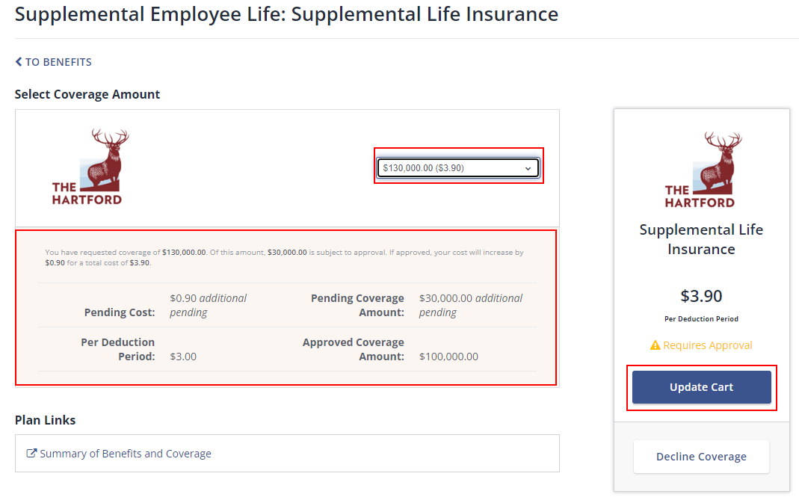
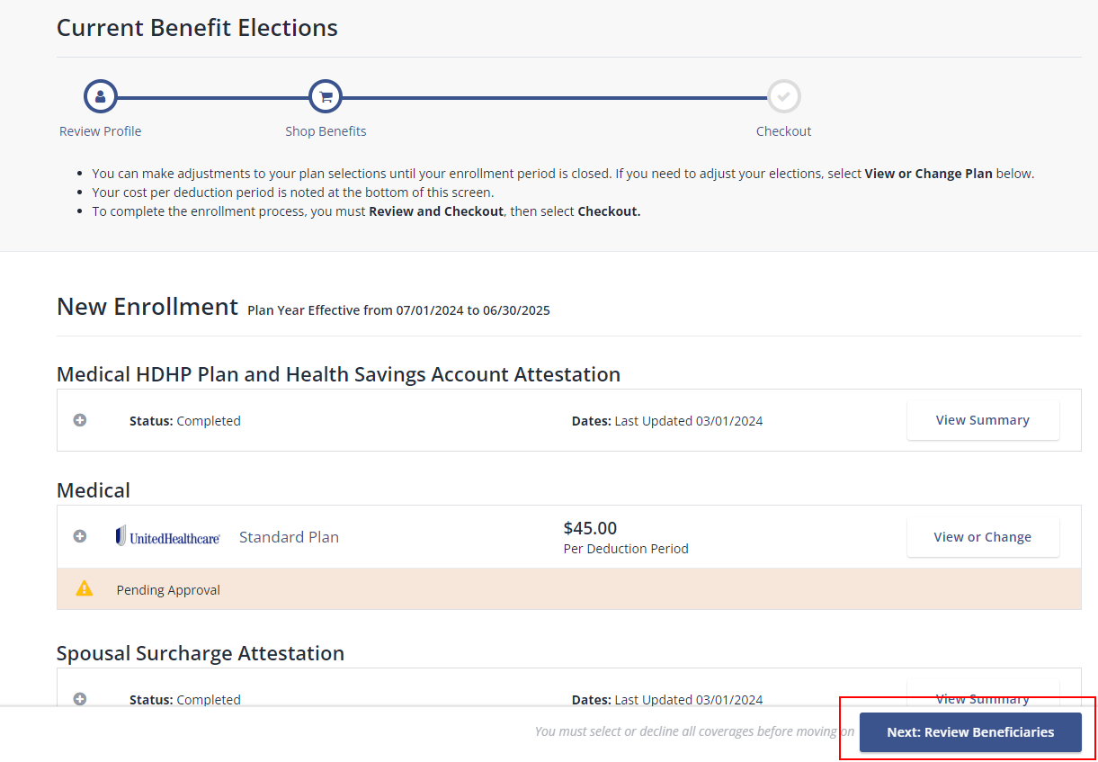
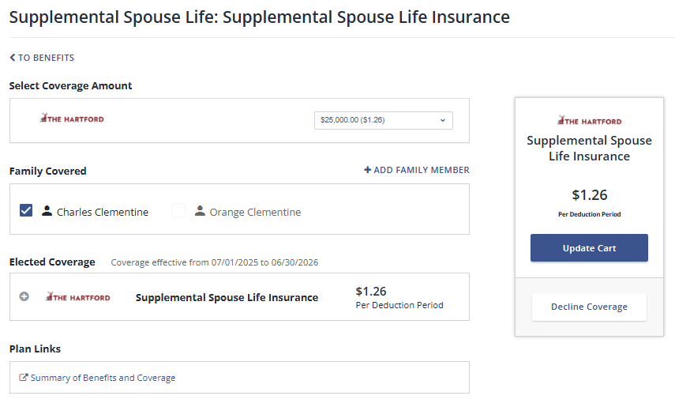
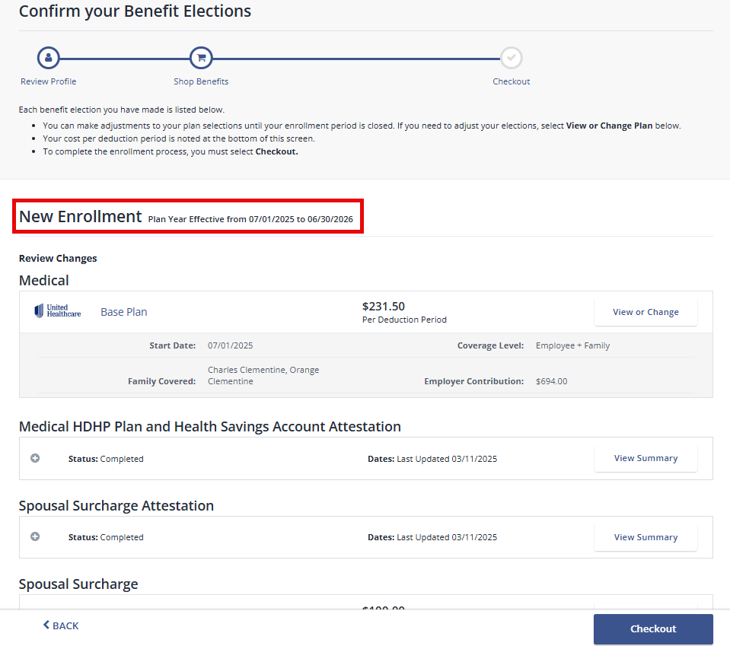
Quick Reference Guide: Employee New Hire Enrollment
21. Employer paid benefits, with no cost to you, will not have a decline coverage option. Click Update Cart to move forward.
22. If enrolling in Supplemental Life Insurance, choose your desired coverage amount from the drop down. Click Update Cart or Decline Coverage.
23. Review your Benefit Elections. All offerings must have an enrollment or decline on file. Click Next: Review Beneficiaries.
Evidence of Insurability may be required depending on the coverage amount selected. Pending costs and coverage amounts are displayed for your review.
24. If enrolling in Supplemental Life Insurance, choose your desired coverage amount from the drop down. Click Update Cart or Decline Coverage.
25. Repeat Step 24 as needed for Supplemental Spouse and/or Dependent Life.
26. Review your Benefit Elections. All offerings must have an enrollment or decline on file. If you already have Beneficiaries on file, select Checkout.
Evidence of Insurability may be required depending on the coverage amount selected. Pending costs and coverage amounts are displayed for your review.

Slide 6
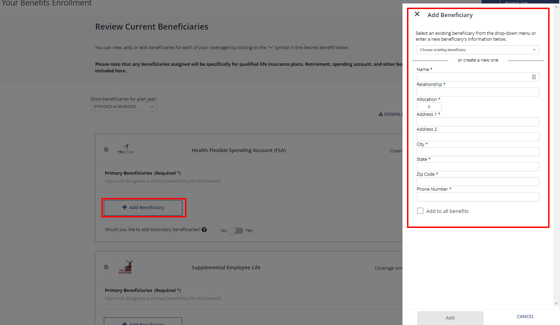
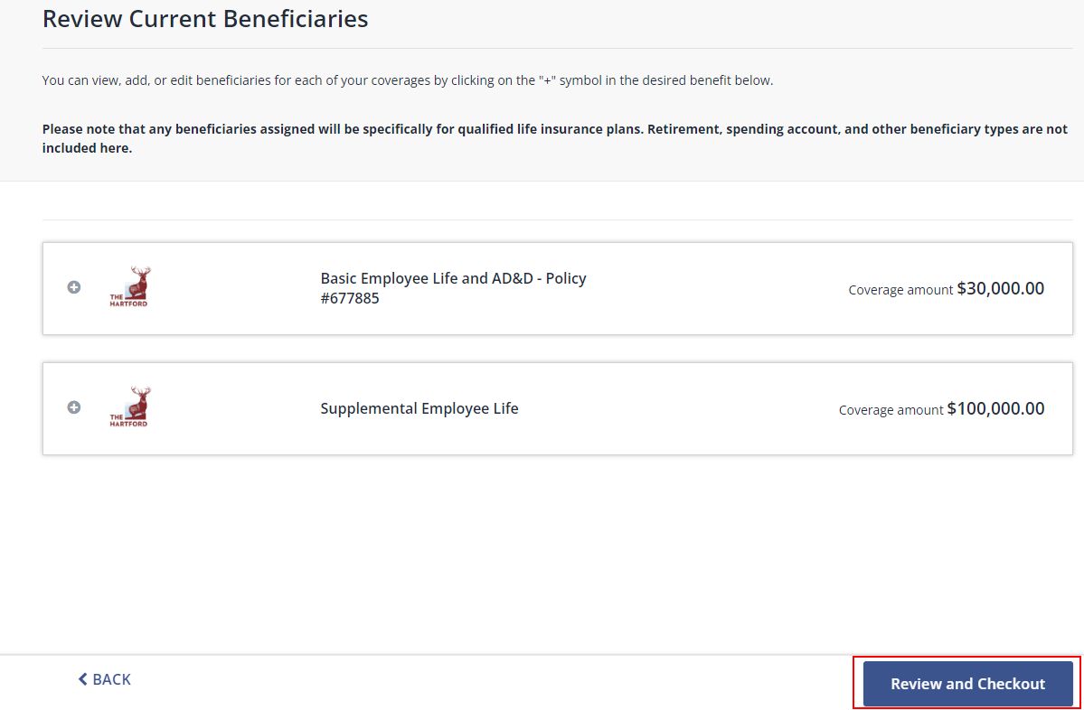
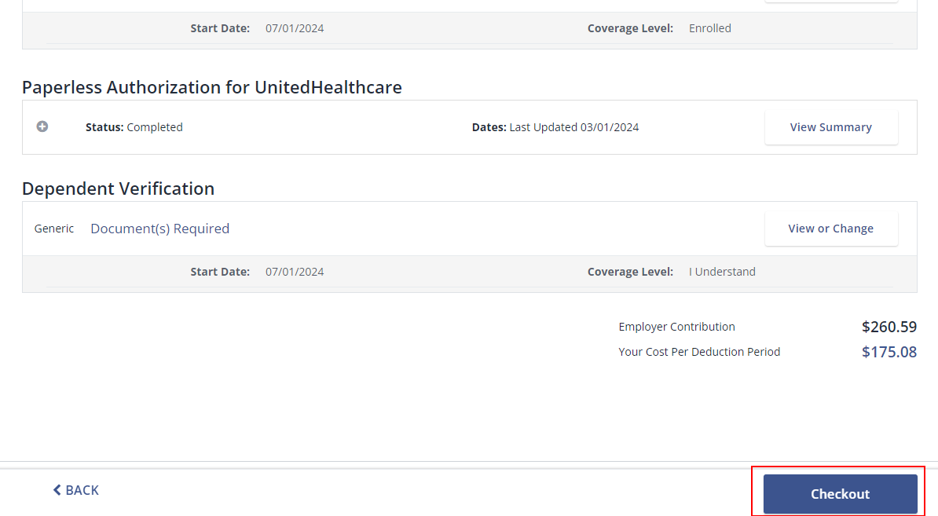
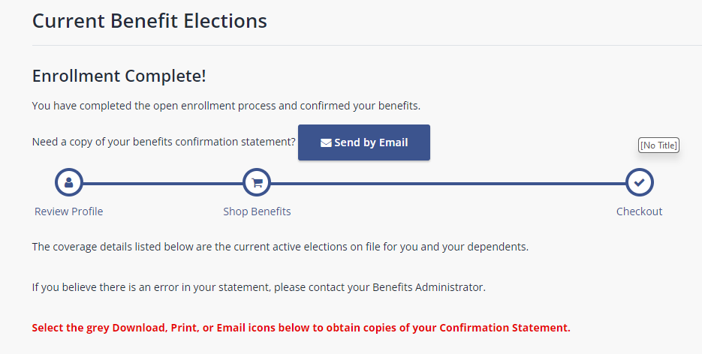
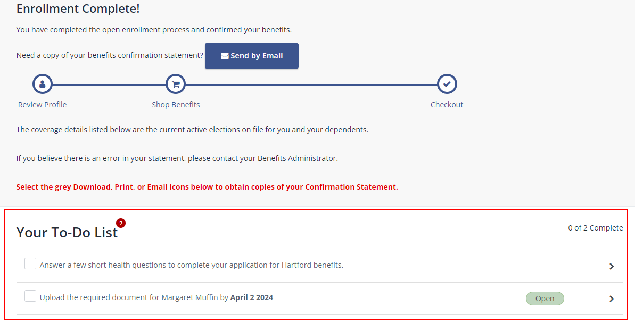
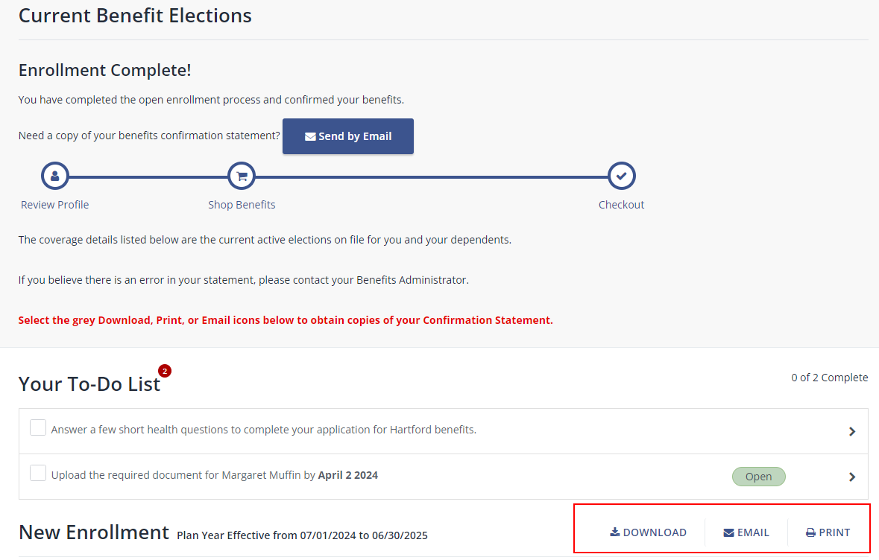
Quick Reference Guide: Employee New Hire Enrollment
27. Click + Add Beneficiary. Enter beneficiary information. The allocation must equal 100% across all beneficiaries. Click Add.
28. Once beneficiary information is complete click Review and Checkout.
29. Review all elections and Checkout. Note: if you do not complete this step, your elections will not be active.
30. Your Enrollment is Complete!
31. Review and complete any additional tasks on Your To-Do List.
32. Download, Print, or Email your Benefits Confirmation Statement.

