Slide 1
Archdiocese of St. Louis
SuccessFactors/ArchHR
Log In Procedures
Date: 11/14/2023

Slide 2
Agenda
TOPICS
Steps to log into SuccessFactors (ArchHR)
Email requirements & recommendations

Slide 3
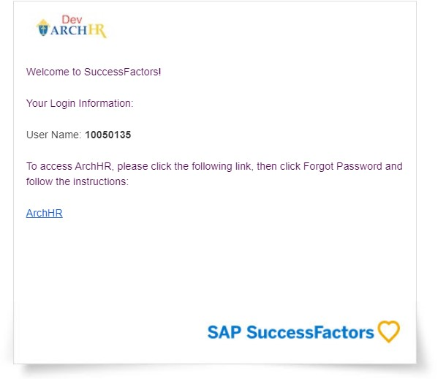
Steps to log into SuccessFactors (ArchHR)
Step #1 | Screenshot
All current employees will first receive a welcome email from ArchHR once the system is made available for general use. Note: Employees must have either a work email or a personal email in the business email field in SuccessFactors to use ArchHR. Veritas Prime will import all emails provided by the Archdiocese of St. Louis as part of the employee data migration to ArchHR Production.

Slide 4
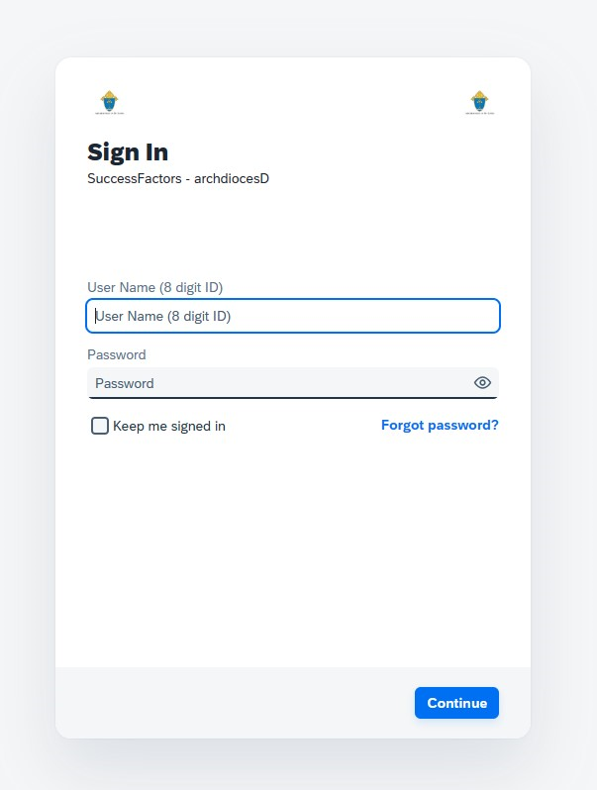
Steps to log into SuccessFactors (ArchHR)
Screenshot | Step #2
 | Upon selecting the ArchHR hyperlink in the email, a web browser link will open with the log in portal. Users should then select the “Forgot Password” link.

Slide 5
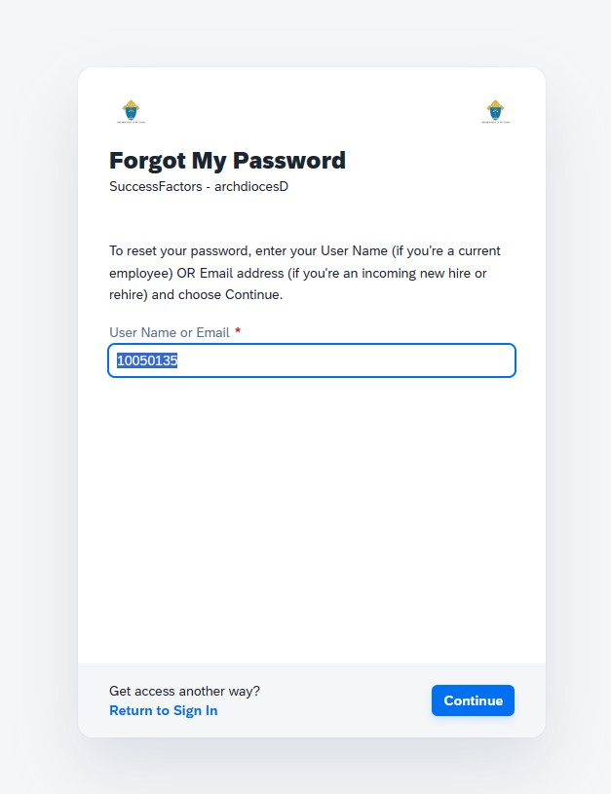
Steps to log into SuccessFactors (ArchHR)
Screenshot | Step #3
 | Users must then enter the user name, which is the 8-digit ID provided in the email from step #1. This 8-digit ID is unique to each user.

Slide 6
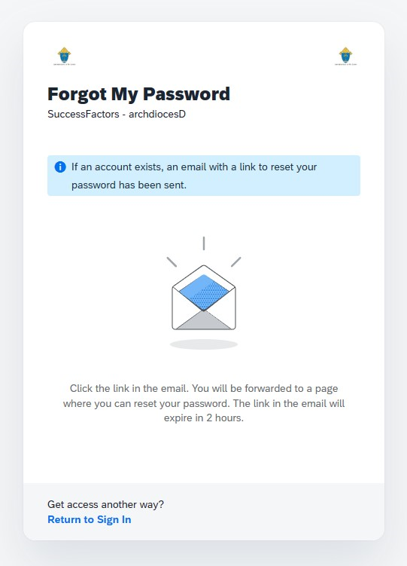
Steps to log into SuccessFactors (ArchHR)
Screenshot | Step #4
 | Users will see a confirmation stating that an email has been sent to them with a link to reset their ArchHR password.

Slide 7
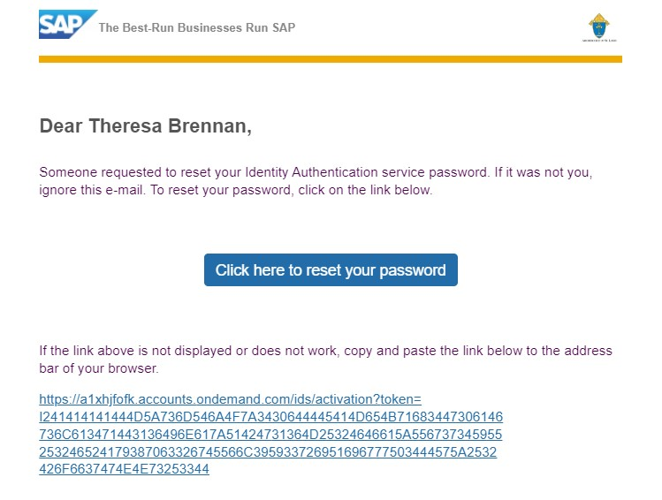
Steps to log into SuccessFactors (ArchHR)
Screenshot | Step #5
 | Users will receive an email with a button labeled “Click here to reset your password”. Users should press the button to move to the next step.

Slide 8
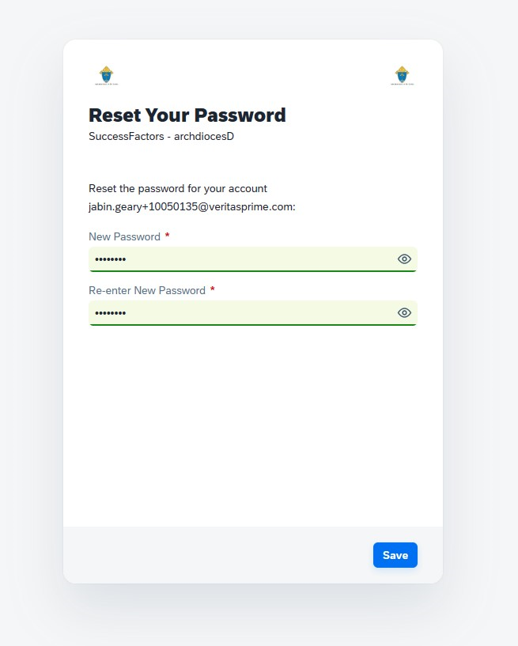
Steps to log into SuccessFactors (ArchHR)
Screenshot | Step #6
 | Users will be prompted to enter a personalized password of their choosing which conforms to the security settings Users should press the “Save” to move to the next step. Note: This personalized password will be the user’s ArchHR password going forward unless the user chooses to reset it again using the “Forgot Password” option.

Slide 9
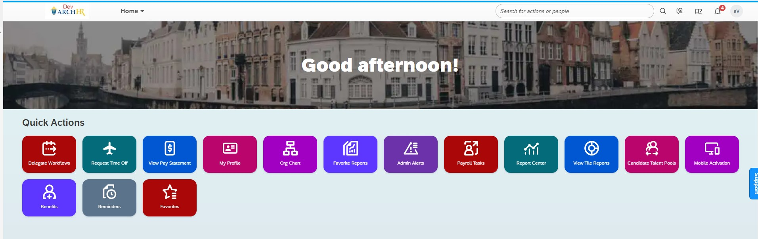
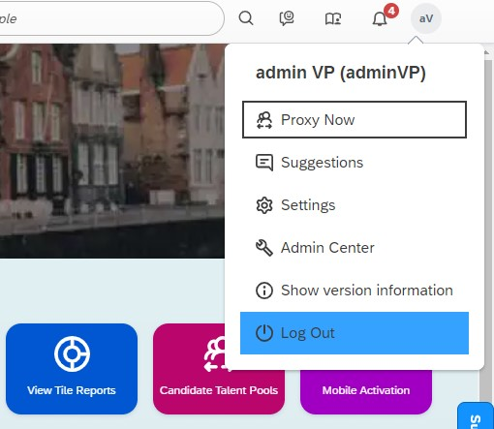
Steps to log into SuccessFactors (ArchHR)
Screenshot | Notes
Upon completing Step #6, the user is logged into ArchHR! | After a certain period of inactivity (say 15 minutes), users will automatically be logged out and must log in again to access ArchHR. Users may also choose to log out manually using the icon in the top right if they’ve finished their tasks.

Slide 10
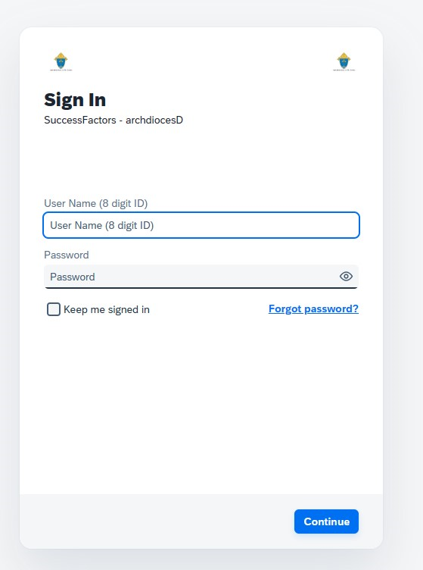
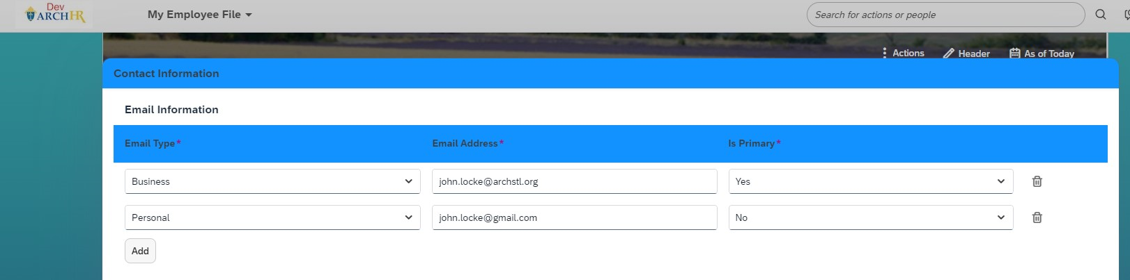
ArchHR password resets
ArchHR password resets | Email requirements
If a user needs to reset their password for any reason, they may do so using the “Forgot password?” link on the same ArchHR log in portal. | To reset their password, users need an email address in ArchHR to receive the reset link. This ArchHR email may be either a business email or a personal email; however, the value must be in the business email field in ArchHR, even if it’s personal, to enable password resets.

Slide 11
Thank you!

